Slide 1
ANSI SQL
Understanding SQL

Slide 2

Session Objectives
At the end of the session you will be able to
Introduction to SQL/NoSQL
Define Database Management System (DBMS)
Define Database (DB)
Define Relational Database Management System (RDBMS)
Describe Database Normalization
Define Structured Query Language (SQL)

Slide 3
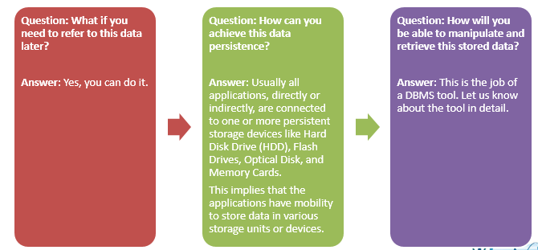
Introduction
You might have encountered a need to retain the data which is input, manipulated, and displayed by your code. Program manipulates data in RAM which is volatile storage.

Slide 4
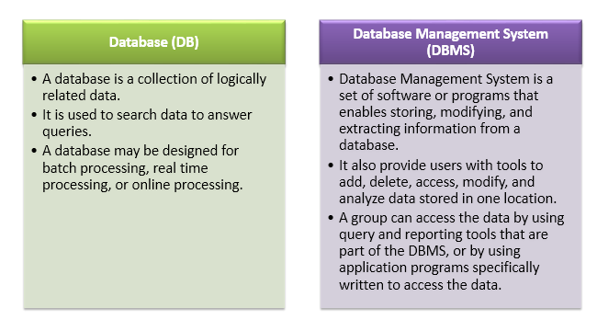
What Is DBMS?

Slide 5
What Is RDBMS?
Relational Database Management System (RDBMS) is a Database Management System (DBMS) that is based on the Relational model.
Relational data model is the primary data model, which is used widely around the world for data storage and processing. This model is simple and it has all the properties and capabilities required to process data with storage efficiency.

Slide 6
Introduction to SQL/NoSQL
SQL
Structured Query language (SQL) is the standard language for dealing with Relational Databases.
A relational database defines relationships in the form of tables.
SQL programming can be effectively used to insert, search, update, delete database records.
MySQL Database, Oracle, Ms SQL Server, Sybase all uses SQL
NO SQL
NoSQL is a non-relational DMS,
It does not require a fixed schema
NoSQL is a Non-relational or Distributed Database.
NoSQL databases can be document based, key-value pairs,
NoSQL database technologieswere developed in response to the demands presented for the development of the modern application.
Mongodb,Apache Cassandra,google cloud table,CouchDB

Slide 7
Advantages & Disadvantages SQL/NoSQL
SQL
Vertically scalable
Table based Structure
databases have fixed or static or predefined schema
These databases are not suited for hierarchical data storage
These databases are best suited for complex queries
SQL databases follow ACID properties (Atomicity, Consistency, Isolation and Durability)
Vendor support is there for SQL database for a very large scale deployments
NO SQL
Horizontally scalable
Key value Pair, document based and graph dbs
have dynamic schema
These databases are best suited for hierarchical data storage.
These databases are not so good for complex queries
NoSQL database follows the Brewers CAP theorem (Consistency, Availability and Partition tolerance).
Community support only is available

Slide 8
Database Normalization
How to reduce data redundancy and inconsistency in database tables?
Data redundancy and inconsistency in database tables can be reduced by following a process called Normalization
Database Normalization:
Database Normalization is the process of organizing the fields and tables of a relational database to minimize redundancy and dependency.
Normalization usually involves dividing large tables into smaller (and less redundant) tables and defining relationships between them.
The objective is to isolate data so that additions, deletions, and modifications of a field can be made in just one table and propagated through the rest of the database via defined relationships

Slide 9
Normalization
Normalization is a method to remove all these anomalies and bring the database to a consistent state.
First Normal Form
Second Normal Form
Third Normal From
Boyce code Normal Form

Slide 10
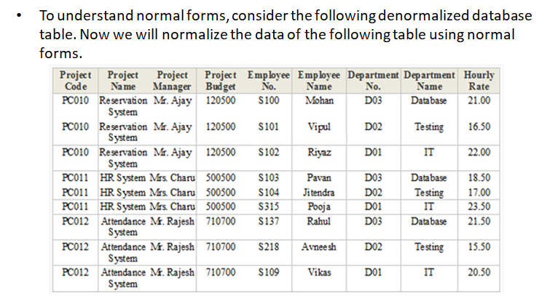
First Normal Form

Slide 11

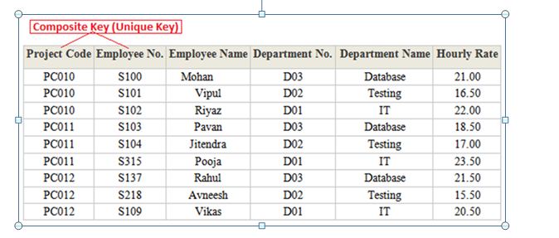
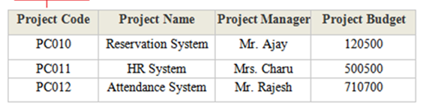

Slide 12

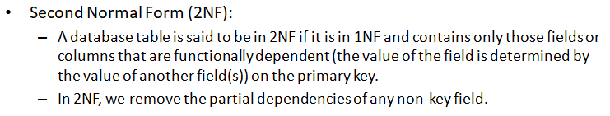
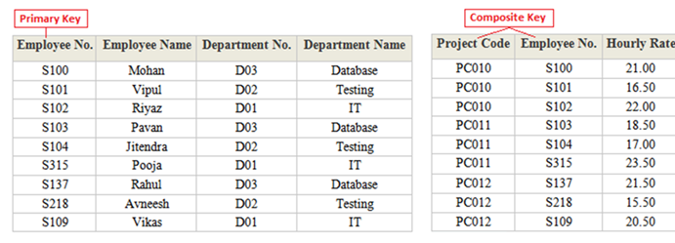
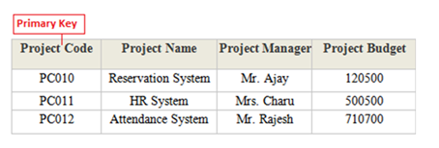

Slide 13

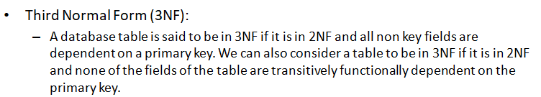
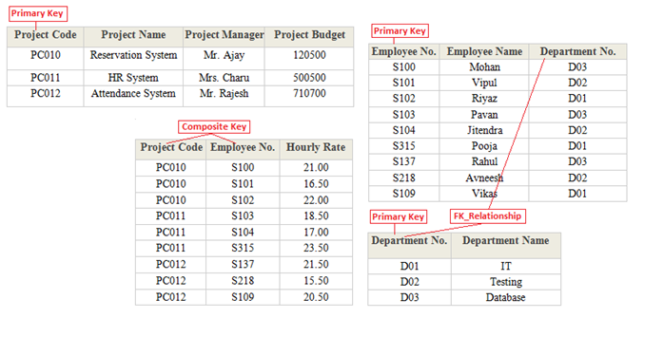

Slide 14


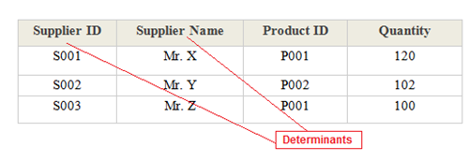
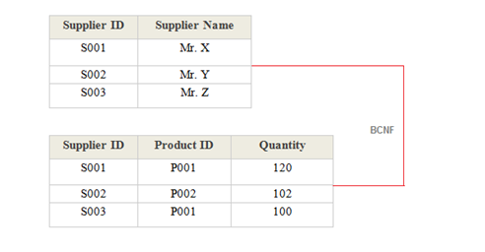

Slide 15
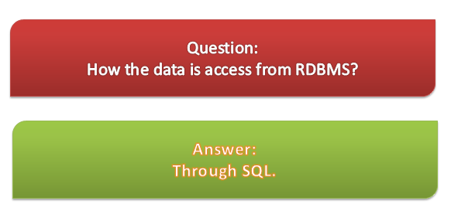
SQL

Slide 16
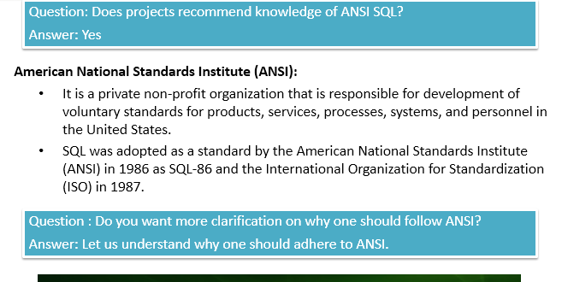
SQL
Structured Query Language
A special purpose programming language designed for managed data in RDBMS.
ANSI SQL

Slide 17
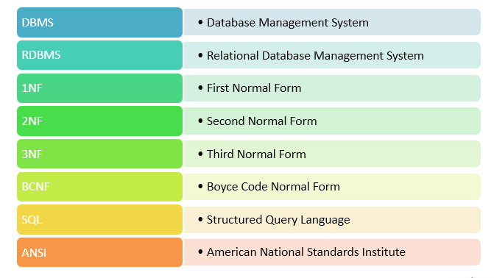
Keywords

Slide 18
You have completed Understanding of SQL

